Slide 1
HTML Forms

Slide 2
Introducing Forms
Section 3 of 6

Slide 3
HTML Forms
Richer way to interact with server
Forms provide the user with an alternative way to interact with a web server.
Forms provide rich mechanisms like:
Text input
Password input
Options Lists
Radio and check boxes

Slide 4
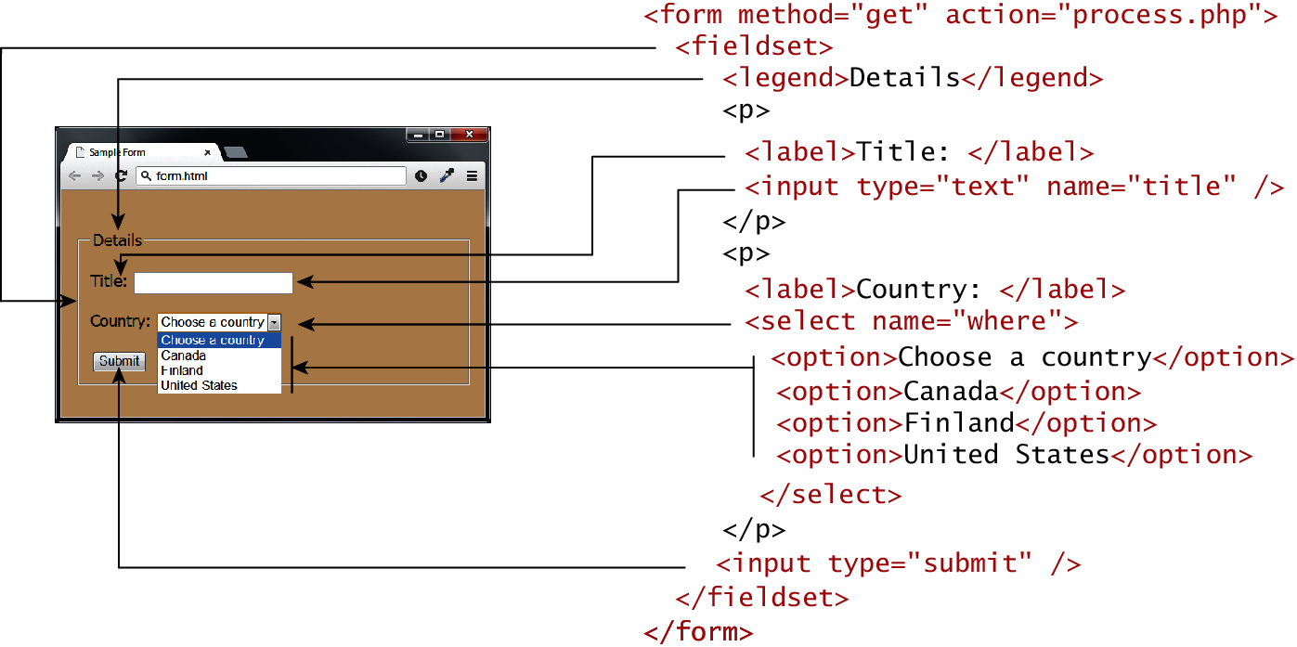
Form Structure

Slide 5
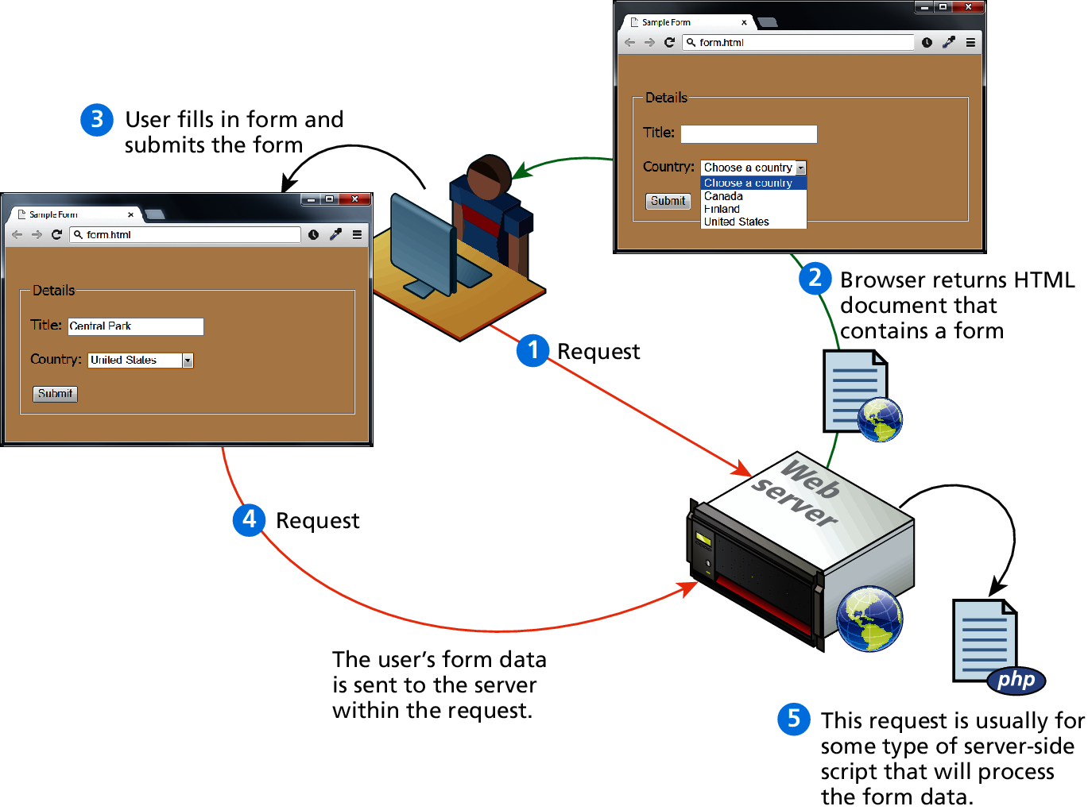
How forms interact with servers

Slide 6
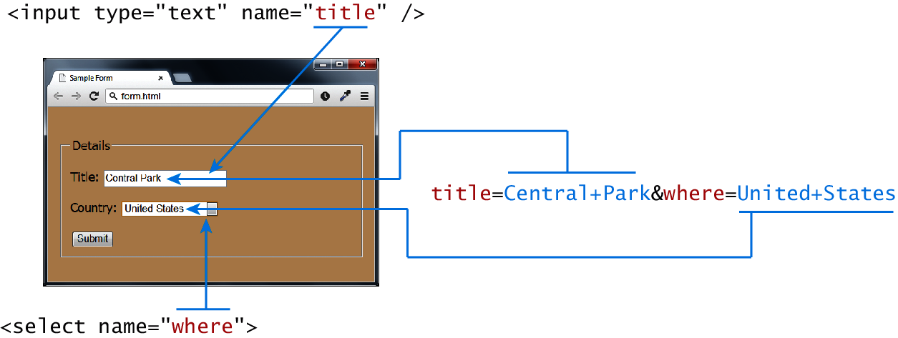
Query Strings
At the end of the day, another string

Slide 7
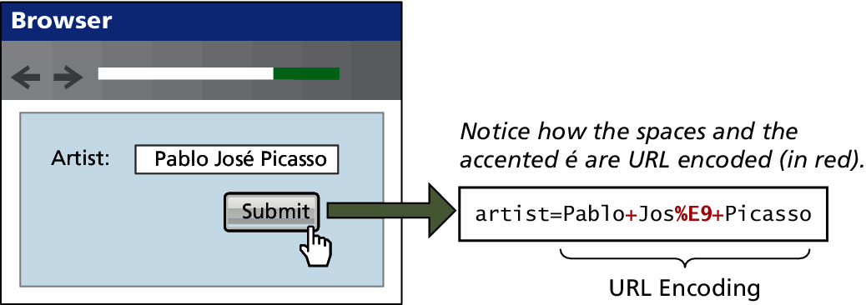
URL encoding
Special symbols

Slide 8
<form> element
Two essential features of any form, namely the action and the method attributes.
The action attribute specifies the URL of the server-side resource that will process the form data
The method attribute specifies how the query string data will be transmitted from the browser to the server.
GET
POST

Slide 9
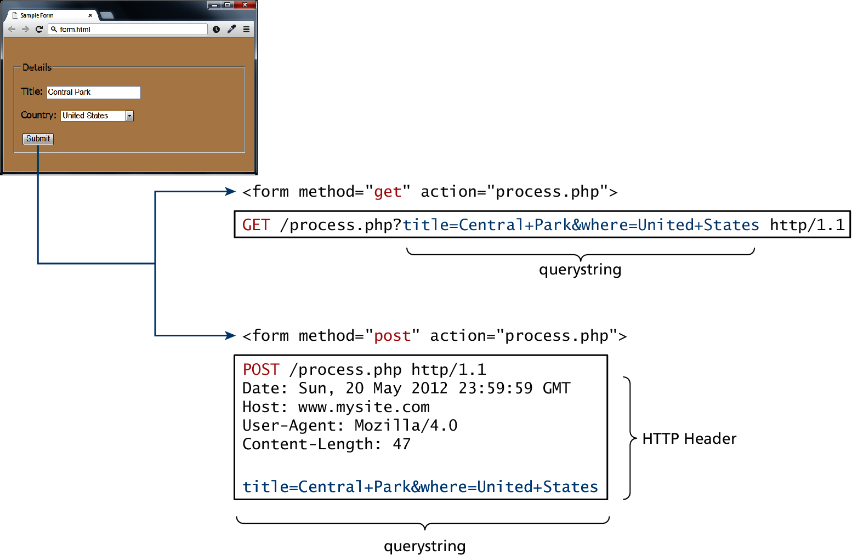
GET vs POST

Slide 10
GET vs POST
Advantages and Disadvantages
GET
Data can be clearly seen in the address bar.
Data remains in browser history and cache.
Data can be bookmarked
Limit on the number of characters in the form
data returned.
POST
Data can contain binary data.
Data is hidden from user.
Submitted data is not stored in cache, history,
or bookmarks.

Slide 11
Forms Control Elements
Section 4 of 6

Slide 12
Form-Related HTML Elements
Type | Description
<button> | Defines a clickable button.
<datalist> | An HTML5 element form defines lists to be used with other form elements.
<fieldset> | Groups related elements in a form together.
<form> | Defines the form container.
<input> | Defines an input field. HTML5 defines over 20 different types of input.
<label> | Defines a label for a form input element.
<legend> | Defines the label for a fieldset group.
<option> | Defines an option in a multi-item list.
<optgroup> | Defines a group of related options in a multi-item list.
<select> | Defines a multi-item list.
<textarea> | Defines a multiline text entry box.

Slide 13
Text Input Controls
Type | Description
text | Creates a single line text entry box. <input type="text" name="title" />
textarea | Creates a multiline text entry box. <textarea rows="3" ... />
password | Creates a single line text entry box for a password <input type="password" ... />
search | Creates a single-line text entry box suitable for a search string. This is an HTML5 element. <input type="search" … />
email | Creates a single-line text entry box suitable for entering an email address. This is an HTML5 element. <input type="email" … />
tel | Creates a single-line text entry box suitable for entering a telephone. This is an HTML5 element. <input type="tel" … />
url | Creates a single-line text entry box suitable for entering a URL. This is an HTML5 element. <input type="url" … />

Slide 14
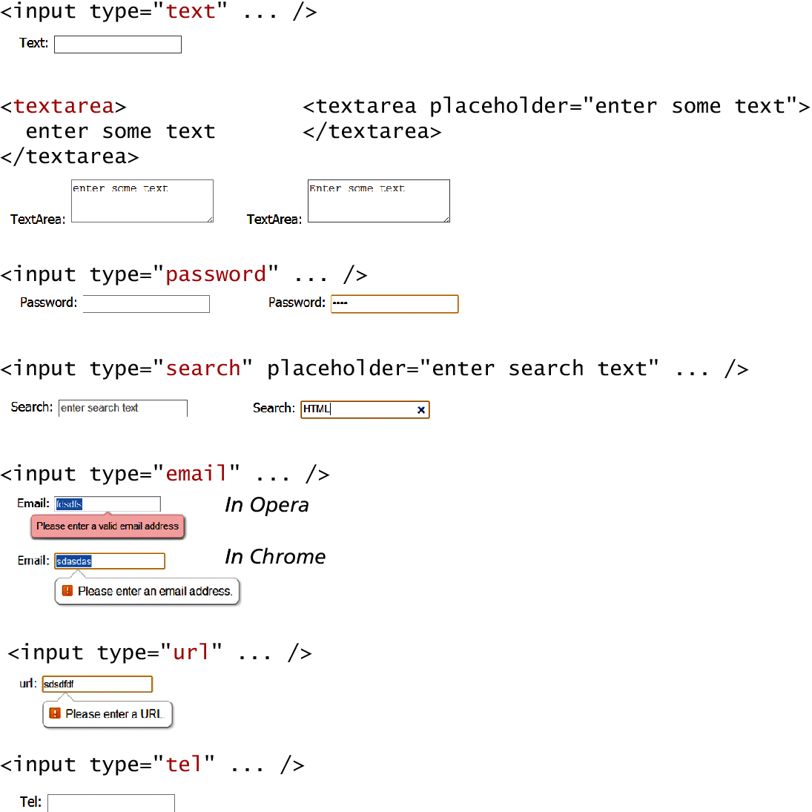
Text Input Controls
Classic

Slide 15
Text Input Controls
HTML5

Slide 16
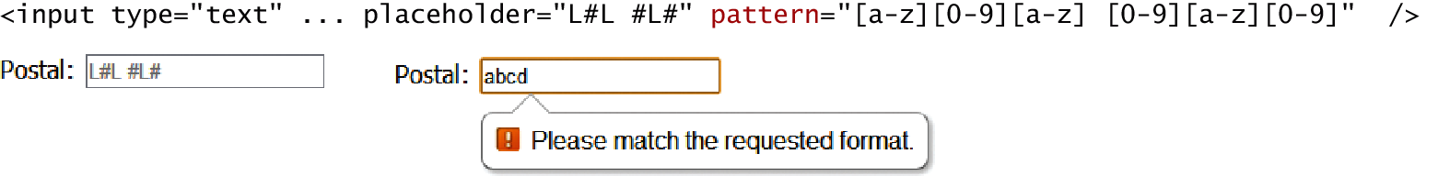
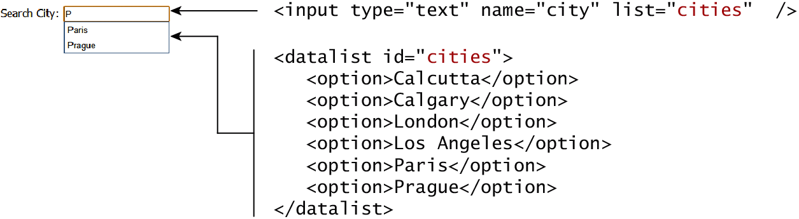
HTML5 advanced controls
Pattern attribute
datalist

Slide 17
Select Lists
Chose an option, any option.
<select> element is used to create a multiline box for selecting one or more items
The options are defined using the <option> element
can be hidden in a dropdown or multiple rows of the list can be visible
Option items can be grouped together via the <optgroup> element.

Slide 18
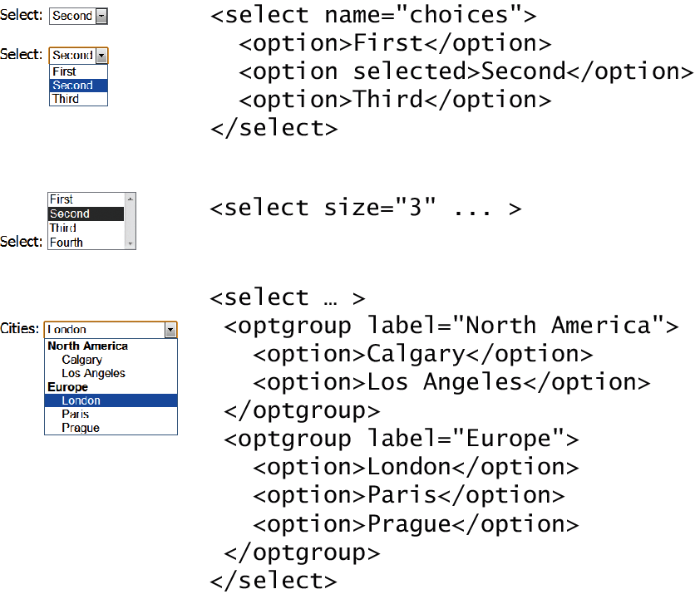
Select Lists
Select List Examples

Slide 19
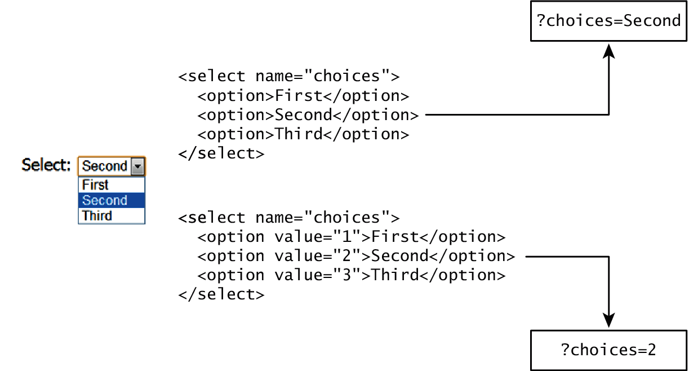
Which Value to send
Select Lists Cont.
The value attribute of the <option> element is used to specify what value will be sent back to the server.
The value attribute is optional; if it is not specified, then the text within the container is sent instead

Slide 20
Radio Buttons
Radio buttons are useful when you want the user to select a single item from a small list of choices and you want all the choices to be visible
radio buttons are added via the <input type="radio"> element
The buttons are mutually exclusive (i.e., only one can be chosen) by sharing the same name attribute
The checked attribute is used to indicate the default choice
the value attribute works in the same manner as with the <option> element

Slide 21
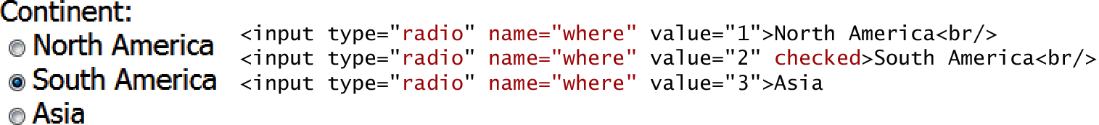
Radio Buttons

Slide 22
Checkboxes
Checkboxes are used for getting yes/no or on/off responses from the user.
checkboxes are added via the <input type="checkbox”> Element
You can also group checkboxes together by having them share the same name attribute
Each checked checkbox will have its value sent to the server
Like with radio buttons, the checked attribute can be used to set the default value of a checkbox

Slide 23
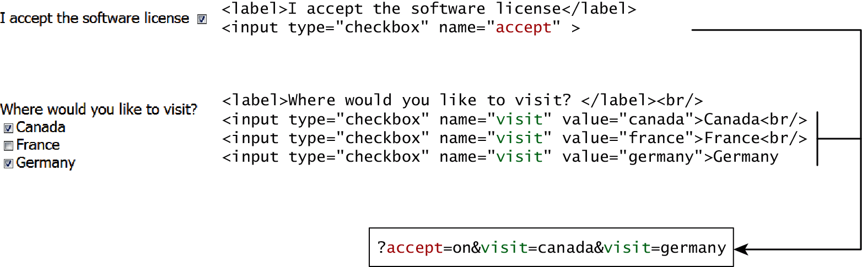
Checkboxes

Slide 24
Button Controls
Type | Description
<input type="submit"> | Creates a button that submits the form data to the server.
<input type="reset"> | Creates a button that clears any of the user’s already entered form data.
<input type="button"> | Creates a custom button. This button may require Javascript for it to actually perform any action.
<input type="image"> | Creates a custom submit button that uses an image for its display.
<button> | Creates a custom button. The <button> element differs from <input type="button"> in that you can completely customize what appears in the button; using it, you can, for instance, include both images and text, or skip server-side processing entirely by using hyperlinks. You can turn the button into a submit button by using the type="submit" attribute.

Slide 25
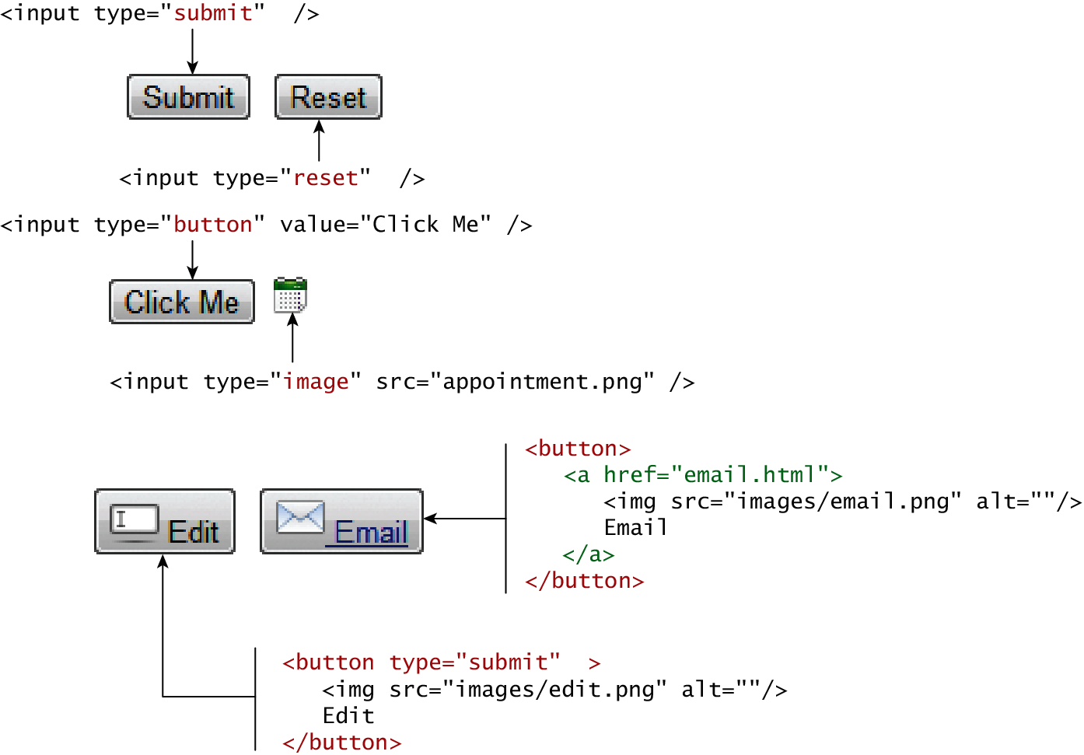
Button Controls

Slide 26
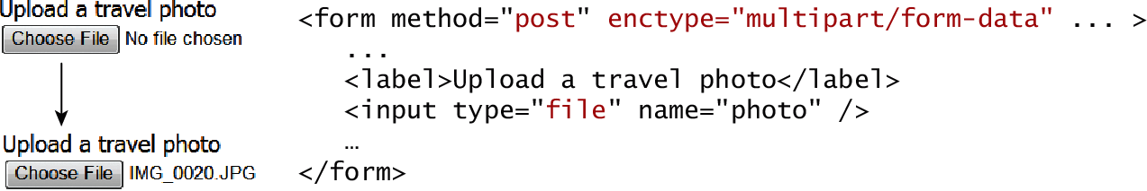
Specialized Controls
I’m so special
<input type=hidden>
<input type=file>

Slide 27
Number and Range
Typically input values need be validated. Although server side validation is required, optional client side pre-validation is good practice.
The number and range controls Added in HTML5 provide a way to input numeric values that eliminates the need for JavaScript numeric validation!!!

Slide 28
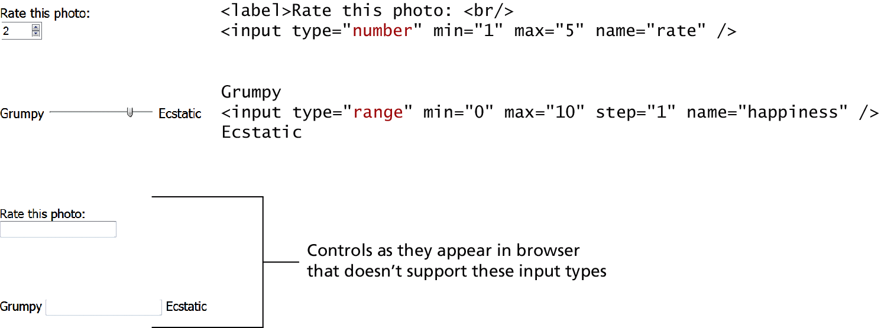
Number and Range
<input type=“number” min=“1” max=“5” name=“rate” />

Slide 29
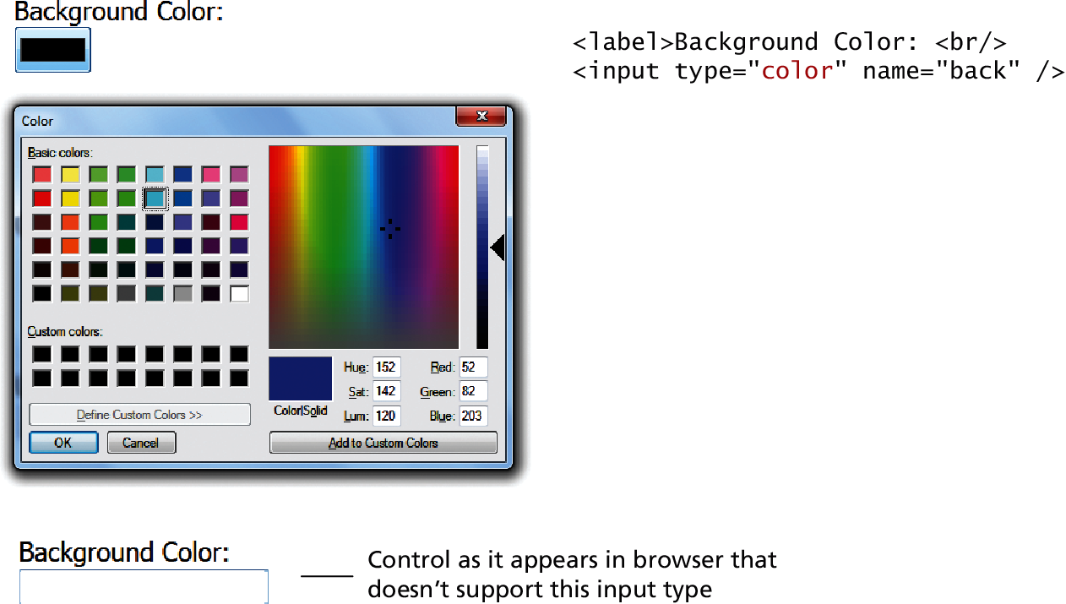
Color

Slide 30
Date and Time Controls
Dates and times often need validation when gathering this information from a regular text input control.
From a user’s perspective, entering dates can be tricky as well:
you probably have wondered at some point in time when entering a date into a web form,
what format to enter it in,
whether the day comes before the month,
whether the month should be entered as an abbreviation or a number, and so on.

Slide 31
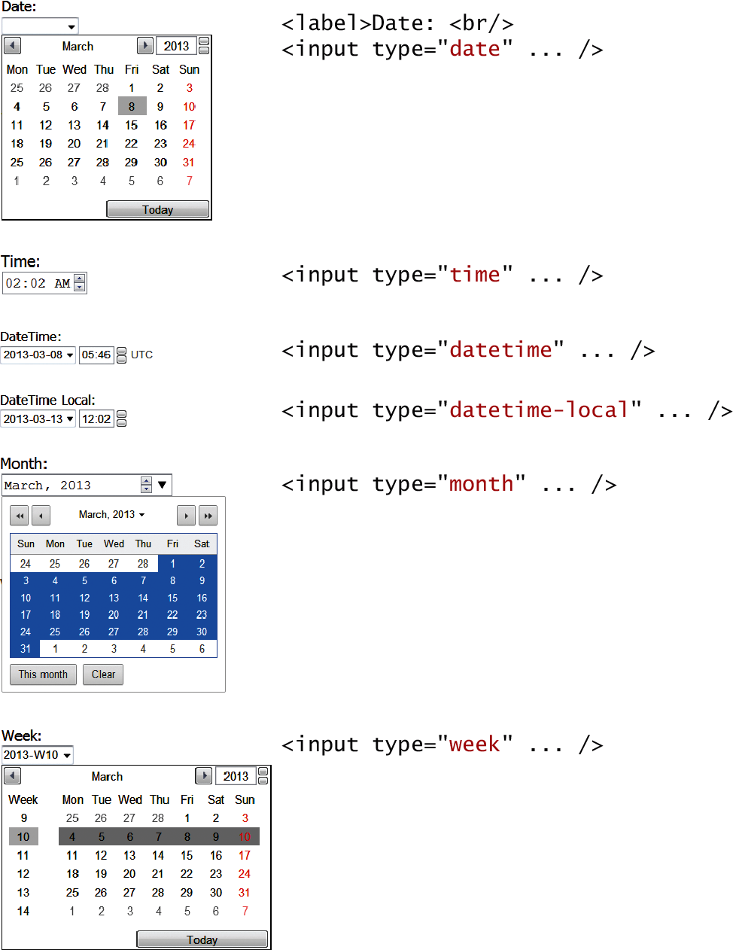
HTML5 Date and Time Controls

Slide 32
HTML5 Date and Time Controls

Slide 33
HTML Controls
Type | Description
date | Creates a general date input control. The format for the date is "yyyy-mm-dd".
time | Creates a time input control. The format for the time is "HH:MM:SS", for hours:minutes:seconds.
datetime | Creates a control in which the user can enter a date and time.
datetime-local | Creates a control in which the user can enter a date and time without specifying a time zone.
month | Creates a control in which the user can enter a month in a year. The format is "yyyy-mm".
week | Creates a control in which the user can specify a week in a year. The format is "yyyy-W##".

Slide 34
Other Controls
You mean there’s more
The <progress> and <meter> elements can be used to provide feedback to users,
but requires JavaScript to function dynamically.
The <output> element can be used to hold the output from a calculation.
The <keygen> element can be used to hold a private key for public-key encryption

Slide 35
Table and form accessibility
Section 5 of 6

Slide 36
Web Accessibility
Not all web users are able to view the content on web pages in the same manner.
The term web accessibility refers to the assistive technologies, various features of HTML that work with those technologies, and different coding and design practices that can make a site more usable for people with visual, mobility, auditory, and cognitive disabilities.
In order to improve the accessibility of websites, the W3C created the Web Accessibility Initiative (WAI)
Web Content Accessibility Guidelines

Slide 37
Web Content Accessibility Guidelines
Provide text alternatives for any nontext content so that it can be changed into other forms people need, such as large print, braille, speech, symbols, or simpler language.
Create content that can be presented in different ways (for example simpler layout) without losing information or structure.
Make all functionality available from a keyboard.
Provide ways to help users navigate, find content, and determine where they are.

Slide 38
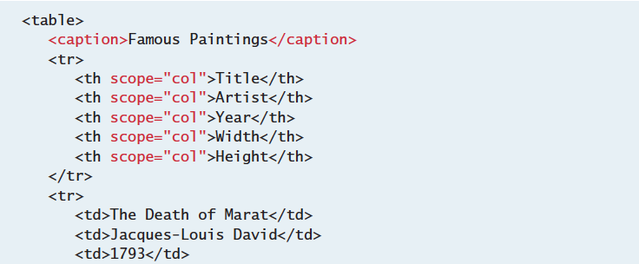
Accessible Tables
Describe the table’s content using the <caption> element
Connect the cells with a textual description in the header

Slide 39
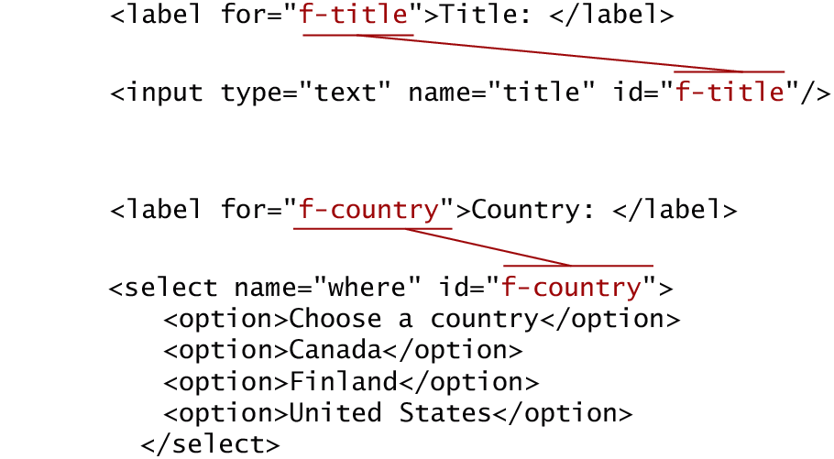
Accessible Forms
Recall the <fieldset>, <legend>, and <label> elements.
Each <label> element should be associated with a single input element.

